Slide 1





Neuroendocrine Activation post-COVID
Ms Anna Kamdar
British Heart Foundation MBPhD fellow

Slide 2
Disclosures
Ms Anna Kamdar receives research funding from the British Heart Foundation (FS/MBPhD/22/28011).
SomaLogic provided the sequencing dataset

Slide 3
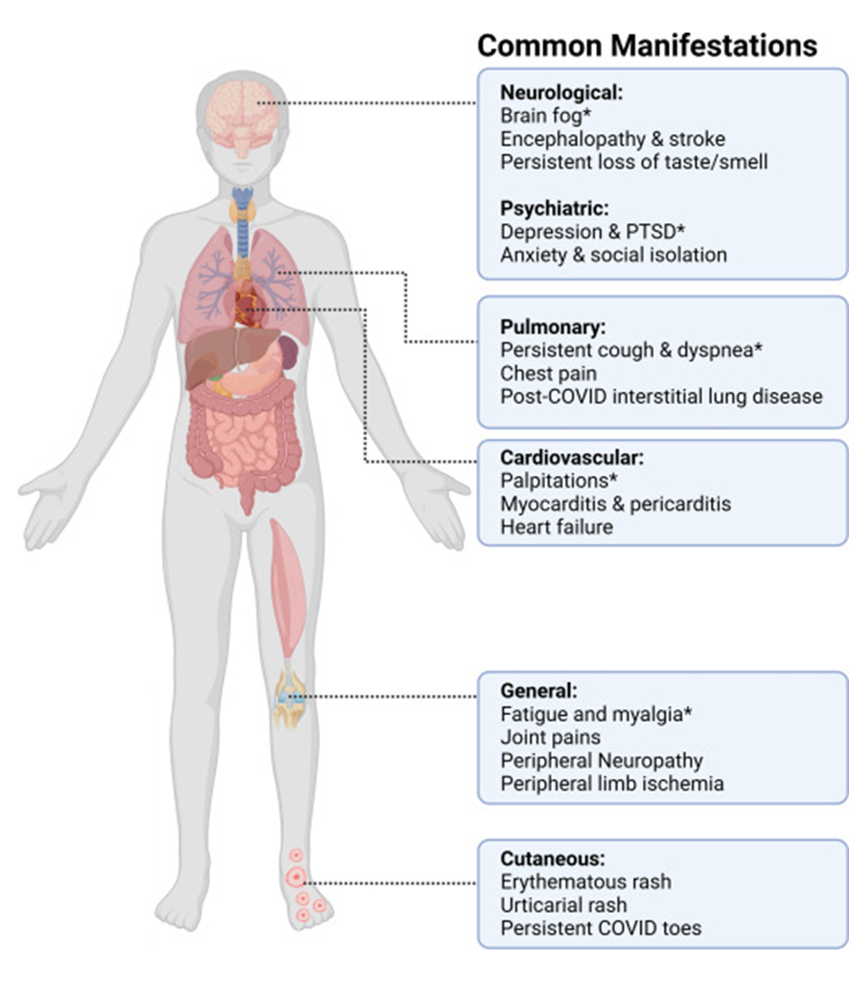
Background
Post-COVID syndromes are poorly understood
Mismatch between symptoms & clinical markers
Catecholamines are central to stress response, potential for dysregulation after COVID
Hypothesis: Dysregulated catecholamine pathways may influence recovery trajectory
Kamdar et al Infectious Medicine 2024

Slide 4


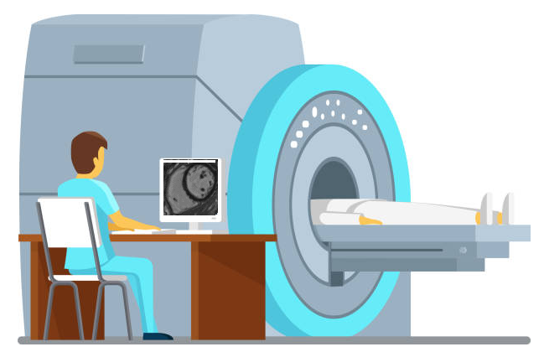



NCT04403607
267 COVID-19 consented, 159 with multisystem imaging
Consultant adjudication panel (n=14) for myocarditis (Lake Louise criteria)
Plasma proteomics, multisystem imaging, biomarkers, tissue samples
  SomaScan v4.1 panel (7288 proteins)
Enrolment (visit 1) and 28-60 days (visit 2)
Morrow, Sykes, McIntosh, Kamdar et al, Nature Med, 2022

Slide 5
Baseline characteristics
N=155 with plasma proteomics
Mean age 55 years
43% Female
47% pre-existing CVD
37% highest quintile of social deprivation
Kamdar , Lee et al, Under Review

Slide 6
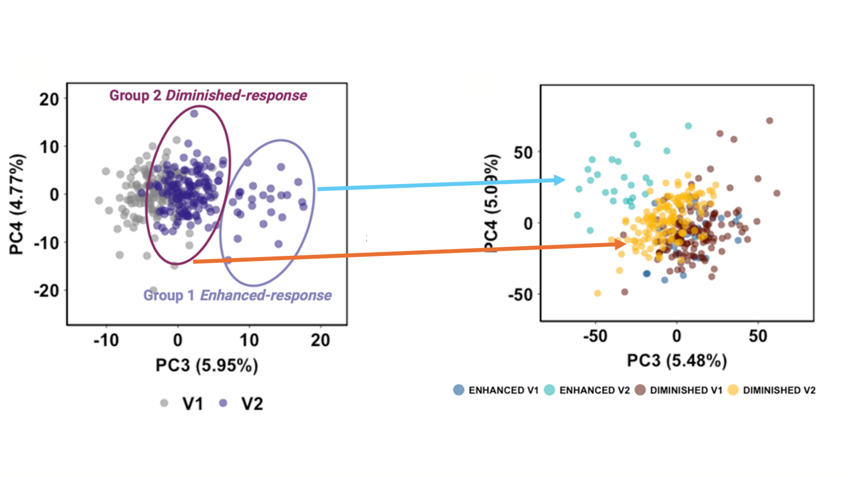
Subgroup (n=25) with distinct catecholamine protein expression
N=401 proteins
N=7288 proteins
Kamdar , Lee et al, Under Review

Slide 7
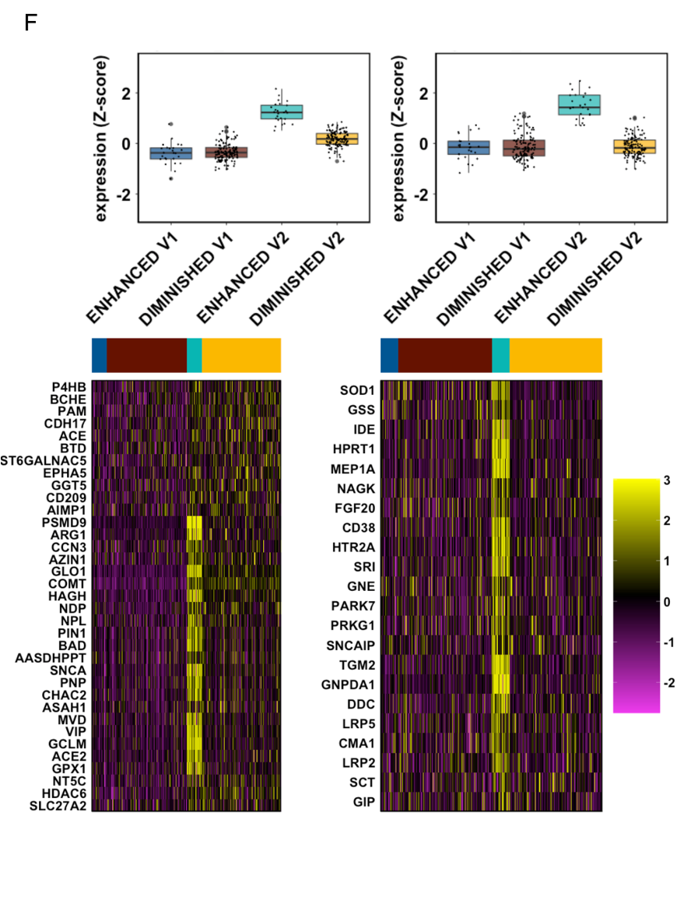
Features
Plasma expression;
↑ Oxidative stress
↑ Mitochondrial dysfunction
Independent of index admission severity and previous mental health diagnosis
Not associated with BMI, Age or time from initial infection
Kamdar , Lee et al, Under Review

Slide 8
Features
Global structural or functional cardiac, lung or renal abnormalities did not define clusters
Enhanced-response participants had elevated biomarkers of endothelial injury at enrolment
Enrolment
ET-1
Factor VIII
vWF antigen
vWF:GP1bR
IL-6
Kamdar , Lee et al, Under Review

Slide 9
Patient Health-Related Quality of Life
Patient reported outcome measure | Enhanced-Response (n=25) | Diminished-Response (n=130) | Standardised mean difference (95%CI)
28-60 day follow up
EQ-5D-5L | 0.7 (0.3) | 0.8 (0.2) | -0.4 (-0.82, 0.05)
PHQ-4 | 2.5 (2.4) | 1.6 (1.9) | 0.4 (-0.06, 0.80)
PHQ-4 Anxiety | 2.2 (2.3) | 1.7 (1.8) | 0.4 (0.01, 0.87)
PHQ-4 Depression | 4.6 (4.4) | 3.3 (3.5) | 0.3 (-0.17, 0.69)
IPAQ MET Unit | 747 (914.4) | 1777 (2604.5) | -0.4 (-0.89, 0.04)
No objective markers of more severe index infection
Anxiety
Illness perception
Exercise capacity
VO₂ max
Kamdar , Lee et al, Under Review

Slide 10
Conclusion
Dysregulated catecholamine biology defines a subgroup with disproportionate symptoms
Disconnect between subjective symptoms & clinical tests
We identify markers with known impacts on vascular and mitochondrial function which could be therapeutic target candidates
Challenge for ongoing research as patients are mostly in community settings
Notes:
It

Slide 11


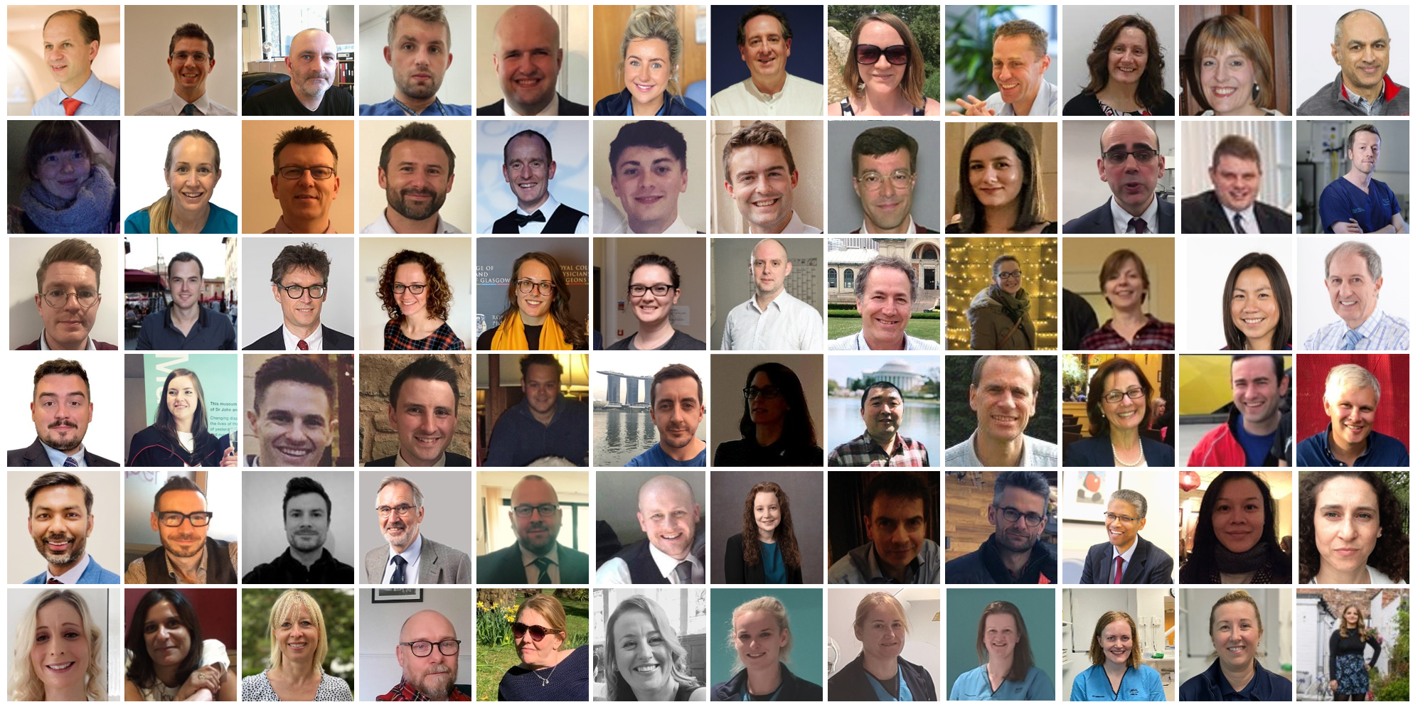
CISCO-19 Investigators; NHS GG&C Biorepository; University of Glasgow - Shared Research Facilities; SomaLogic.

